Slide 1
VALIDATION
What did we learn?

Slide 2
Subtitle subtitle
Valid Hypothesis

Slide 3
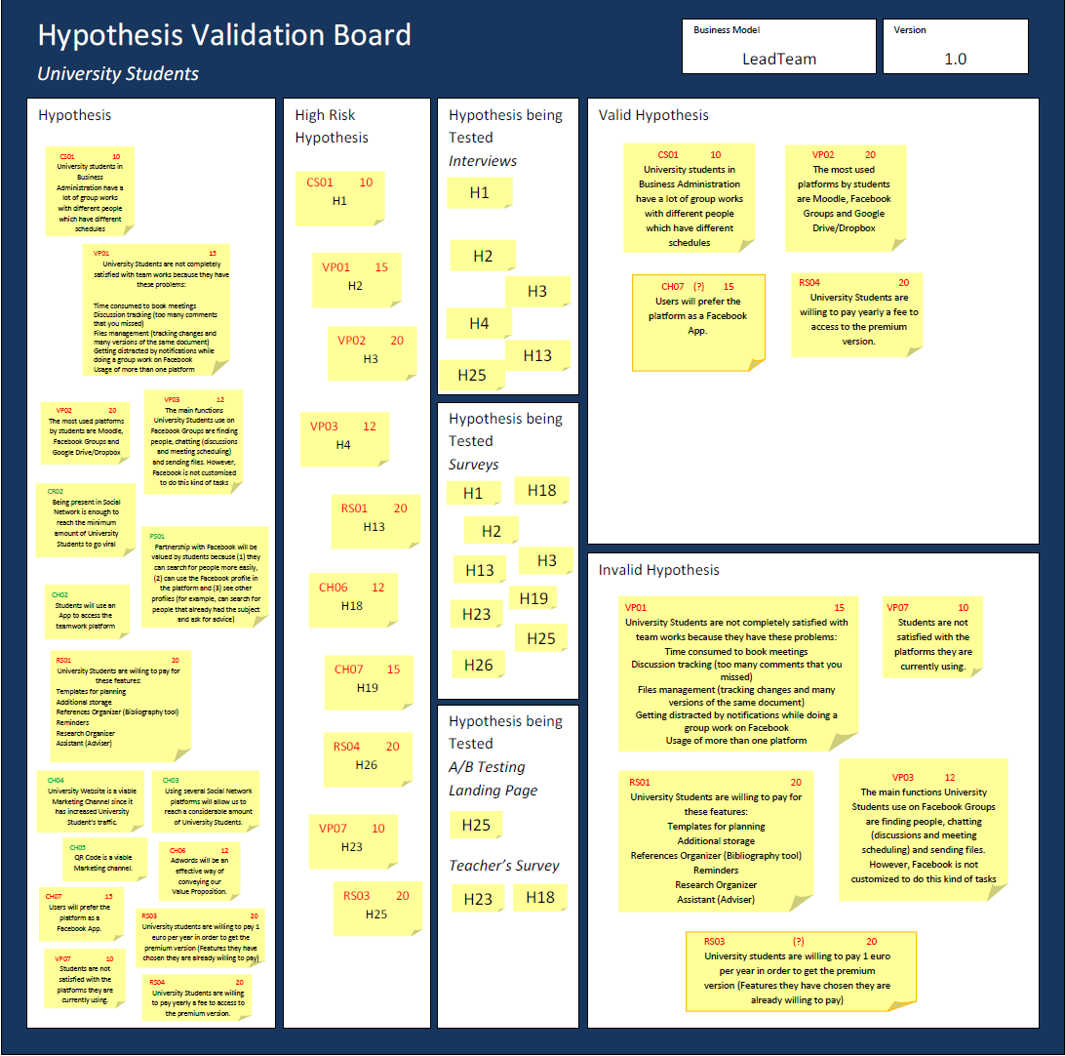

Slide 4
Hypothesis 1
Valid ☺
97% of the Students responded positively to this question.
We confirmed the importance of groupwork in our Customer Segment’s daily lives. Plus, if this Hypothesis was invalid, our Students wouldn’t need any platform for teamwork – they would just meet personally in the University.
Our Solution can actually solve a meaningful problem for them.
Model
Version
Hypothesis Form
leadteam
3.0
Component: Customer segments |  | Code: CS01
Hypothesis | University students have a lot of group works with different people which have different schedules.
Test | Survey 100 and interview 20 university University Students.
Validation | 75% of the students responded “yes”.

Slide 5
Hypothesis 3
Valid ☺
Most University Students use:
Facebook Groups (86%)
Dropbox (63%)
Google Drive (43%)
In-house Platform, such as Moodle (17%)
Model
Version
Version
Hypothesis Form
Model
Hypothesis Form
Hypothesis Form
leadteam
2.0
Component: Value proposition |  | Code: VP02
Hypothesis | The most used platforms by students are Moodle, Facebook Groups and Google Drive/Dropbox.
Test | Survey University Students with 10 possible different tools and choose the 5 they use the most.
Validation | 75% of the students named those 3 in the top 5.

Slide 6
What are the main implications?
Most used platforms
We now are sure we should include these platform’s functions in our website – they are definitely used by our Students.
Facebook - chatting (discuss ideas, share information, book meetings) and task distribution
Cloud service – both like Dropbox (just to share files) and Google Drive (can change documents at the same time)
Moodle – the connection with the University
Almost everyone uses Facebook for teamwork – so the integration suggestion from our interviews is being confirmed in the surveys

Slide 7
Hypothesis 19
Valid ☺
94% of the Students rated 3 or above
76% rated 4 and above
Model
Version
Hypothesis Form
leadteam
2.0
Component: Channels |  | Code: CH07
Hypothesis | Users will prefer the platform as a Facebook App.
Test | Survey 100 University Students from a scale from 1 to 5 (being 1 "I don't like it" to 5 "perfect").
Validation | 80% responded 3 and above.
The crowd is clearly appreciating one of our interviews’ main suggestions

Slide 8
What are the main implications?
We need to test this further – through 20 interviews + 15 surveys to teachers. Will our platform be a Facebook App?
Model
Version
Hypothesis Form
leadteam
3.0
Component: Channels |  | Code: CH07
Hypothesis | Users will prefer the platform as a Facebook App.
Test | Interview 20 students and survey 15 teachers from a scale from 1 to 5 (being 1 "I don't like it" to 5 "perfect").
Validation | 80% responded 3 and above.

Slide 9
Hypothesis 26
Valid ☺
72% of the Students willing to pay, chose a yearly fee
Our Revenue Streams for Universities Students would therefore be:
Freemium with yearly fee
Model
Version
Hypothesis Form
leadteam
1.0
Component: Revenue Streams |  | Code: RS04
Hypothesis | University Students are willing pay yearly a fee to access to premium version.
Test | 100 surveys giving options of yearly fee or fixed initial price (5x yearly fee).
Validation | 70% say they prefer yearly fee.
Version
Hypothesis Form
Hypothesis Form
Hypothesis Form
Hypothesis Form

Slide 10
Subtitle subtitle
Invalid Hypothesis

Slide 12
Hypothesis 2
Model
Version
Invalid
Hypothesis Form
leadteam
1.0
Component: Value proposition |  | Code: VP01
Hypothesis | University Students are not completely satisfied with team works because they have these problems: Time consumed to book meetings Discussion tracking (too many comments that you missed). Files management (tracking changes and many versions of the same document). Getting distracted by notifications while doing a group work on Facebook. Usage of more than one platform.
Test | 100 Surveys ranking the problems described from University Students. 20 interviews from University Students.
Validation | Each problem is at least 75% ranked in the top 3.

Slide 14
Only 54% are frustrated or feel “Middle" about teamwork and the 6 top problems faced are:
Can we add a link to the different social media and e-mail? Can we calculate average response time (teacher could have access to)
People that are not available to promptly respond
Involvement at different levels
Time consumed to book meetings
Files management (tracking changes and many versions of the same document)
Different perspective and expectations for final grades
Don't understand what the teacher wants and the expectation
Can we add an evaluation system, possibly used by the teacher in the final evaluation?
Addressed by our Calendar and Scheduling feature
Addressed by our File Sharing feature – with Docs, Edit and Sketch!
We could create a description box when the teacher uploads the assignment + a forum to discuss between the students of the subject

Slide 15
Hypothesis 4
Invalid
Model
Version
Hypothesis Form
leadteam
1.0
Version
Hypothesis Form
Hypothesis Form
Hypothesis Form
70% thinks Facebook is a good solution.
Component: Value proposition |  | Code: VP03
Hypothesis | The main functions University Students use on Facebook Groups are finding people, chatting (discussions and meeting scheduling) and sending files. However, Facebook is not customized to do this kind of tasks.
Test | 20 interviews to University Students asking (1) for what purposes they use Facebook, regarding team work, and (2) if they believe it is suits the needs.
Validation | 1st part: 50% use Facebook mainly for those functions. 2nd part: 50% said “no”.
Reinforces the Hypothesis we are testing of being integrated into Facebook
Main usages must be incorporated into out platform features:
Chatting (discuss ideas, share
information and book meetings)
File sharing
Task distribution

Slide 16
Hypothesis 13
Invalid
Model
Version
Hypothesis Form
leadteam
3.0
Only 37% are willing to pay for a premium versions
But what features?
Component: Revenue Streams |  | Code: RS01
Hypothesis | Students are willing to pay for these features: Templates for planning; Additional storage; References Organizer (Bibliography tool); Reminders; Research Organizer; Assistant (Adviser).
Test | 20 interviews and 100 surveys.
Validation | 70% of them included these features in their answers.
Hypothesis Form
Hypothesis Form
Hypothesis Form
Hypothesis Form

Slide 17
What features are our Students willing to pay?
Our top 6
Task Allocation
Scheduling and Calendar
File sharing Cloud
Templates planning
References Organizer
Research Organizer
But… aren’t these three crucial in the free version to attract people? Let’s see their priorities!

Slide 18
Which are more important to them?
Top 4
Scheduling and Calendar
File sharing Cloud
Task Allocation
Chat with easy tracking
Essential to be in our Free version to attract students – without them, it won’t bring any value.
We created a MVP with these same features to test with our customers if it corresponds to their expectations!

Slide 19
Free Version - essential
Premium Version - essential
Scheduling and Calendar
File sharing Cloud
Task Allocation
Chat with easy tracking
Templates planning
References Organizer
Research Organizer
Integrating with Universities (?)
Upload directly assignment
Assignment Description
Evaluation metrics
Find team (list of students, who has, who hasn’t team – contact)
Class Page (contact former students)
To resolve problem of not understanding what the teacher wants
Trying to tackle issues such as: people not being available to respond, involvement at different levels…

Slide 20
Hypothesis 25
Invalid (?)
Model
Version
Hypothesis Form
leadteam
3.0
Component: Revenue Streams |  | Code: RS03
Hypothesis | University Students are willing to pay 1€ per year in order to get the premium version (features they chose they already were willing to pay).
Test | 20 students interviews. 100 University Students survey. A/B testing – create one page in which the price is 1€ and another for 2€. See the percentage of visitors that clicked in 1€ and 2€.
Validation | 75% chose 1€ for the features they were willing to pay. The percentage is higher for 1€.
From those willing to pay, how much yearly?
Hypothesis Form
Hypothesis Form
Hypothesis Form
Hypothesis Form
84% of the Students willing to pay chose €1 or more - but only 35% actually said €1

Slide 21
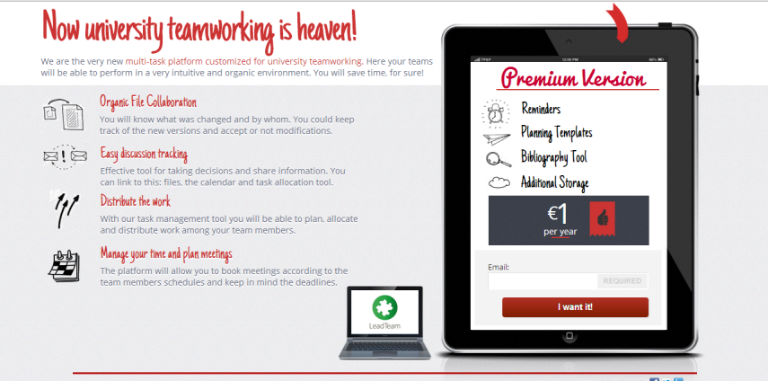
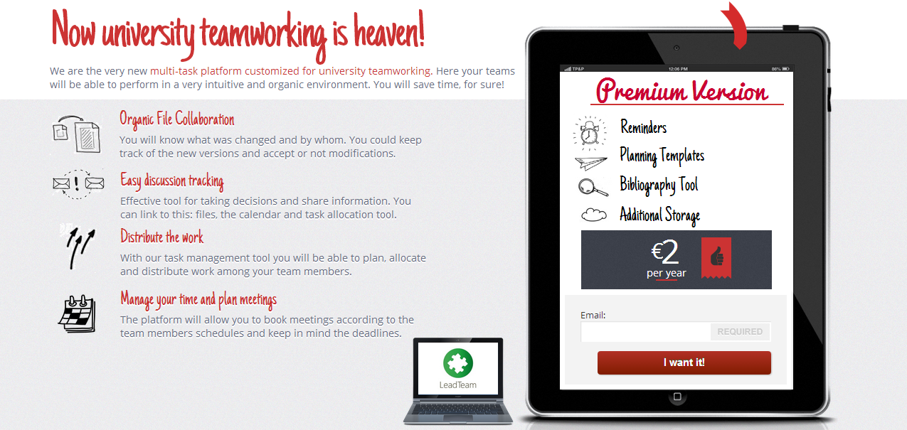
Question: Should we charge €2 or €1 yearly for our Premium Version?
How much are our Students willing to pay?
Further Testing with A/B Landing Page!

Slide 22
Hypothesis 23
Invalid
for University Students
Model
Version
Hypothesis Form
leadteam
1.0
The average is 5,3
+
In the interviews 50% of the students felt good towards their current solution
Component: Customer segments |  | Code: VP
Hypothesis | Students are not satisfied with the platforms they are currently using.
Test | Survey 15 University Teachers and 100 University Students
Validation | On a scale from 1 (worst) to 7 (best) the average is below 4

