Slide 1
U n i v e r s i t y T e a m w o r k P l a t f o r m

Slide 2
Digital dependent university students

Slide 3
Digital dependent university students
Business & Economics Universities

Slide 4
Digital dependent university students
Companies
targeting students segment
Business & Economics Universities

Slide 5
“More than 1 platform”
Teamworks
Frustration rate
= 54%
“Time-consumption to
book meetings”
“Involvement at
different levels”

Slide 6
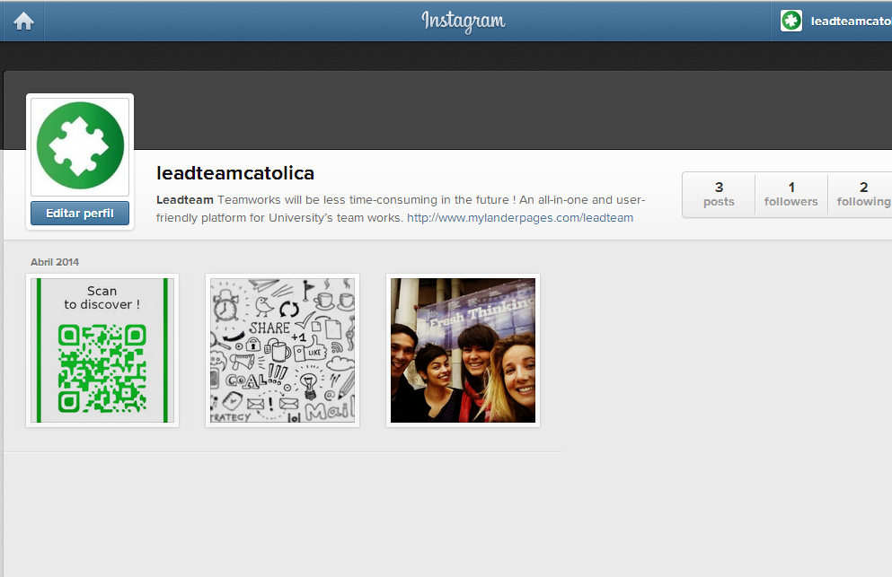
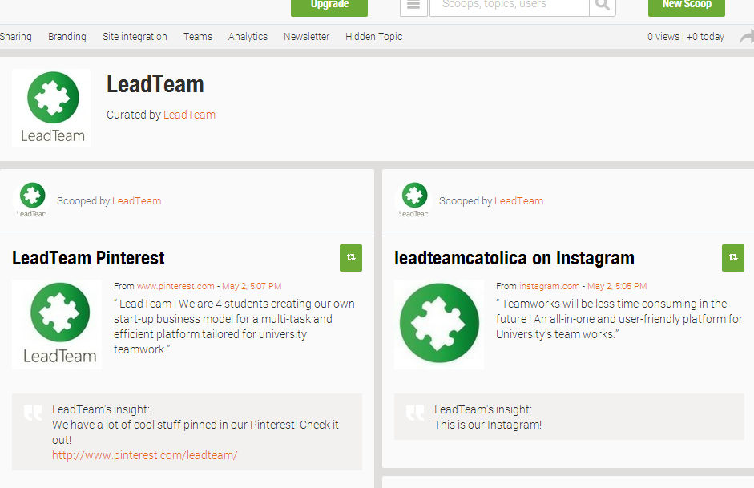
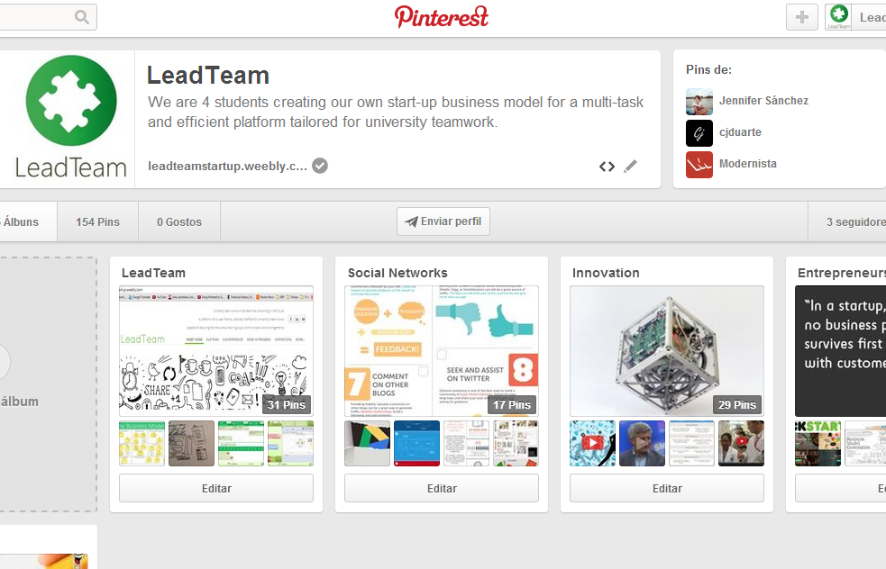
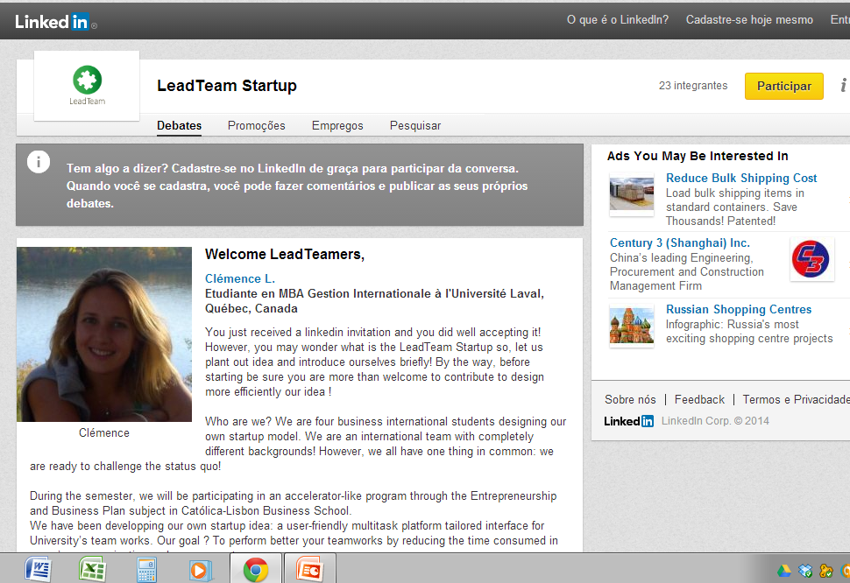
Videos
VIRAL MARKETING
€6.500
PPC
€61.593
SOCIAL MEDIA
Competition
€78.953
€7.716
MARKETING AND SALES EXPENSES
USERS

Slide 7
Fairs
SEO and the LeadTeam platform
E-mail Marketing and Tele-Marketing

Slide 8
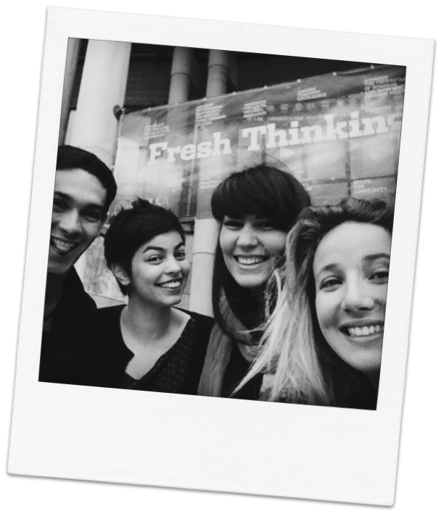
juan.designer.co
ana.hustler.pt
victoria.systematic.fr
clémence.innovator.fr

Slide 10
593
124
6
25
0
NOW
2M
418K
20K
9K
18 848 users
5 universities
1st YEAR

Slide 11
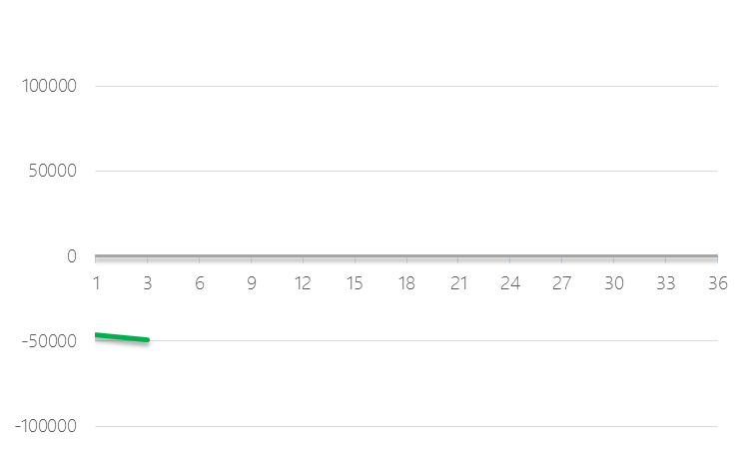
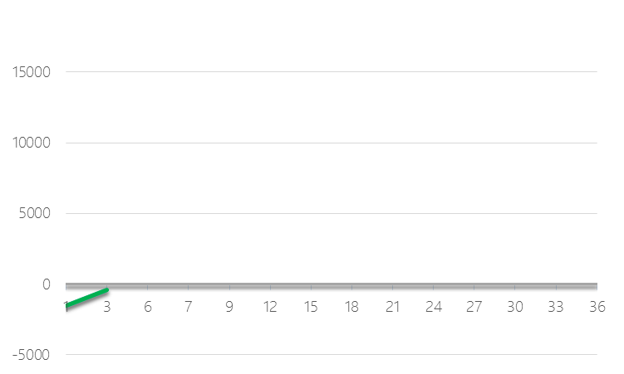
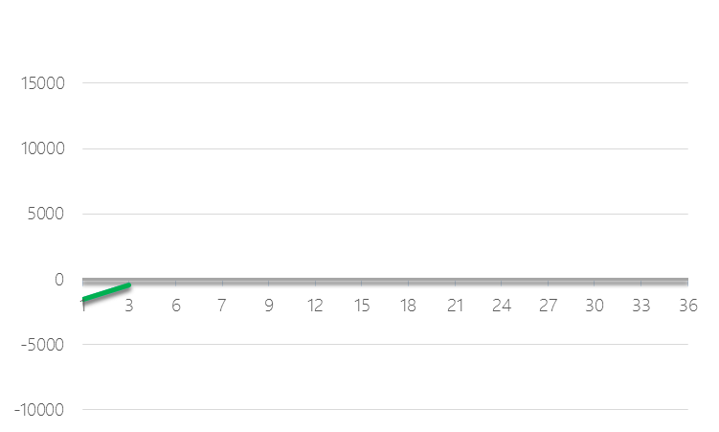
10.000
+4
1/2
ucp
Net income
Cumulative FCF

Slide 12
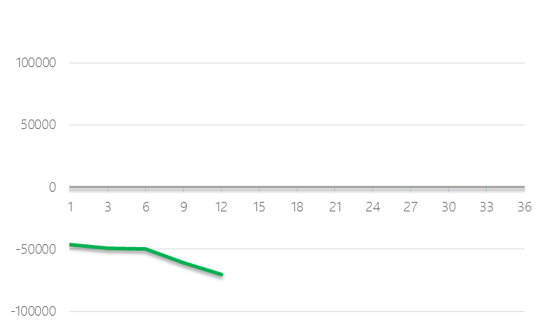
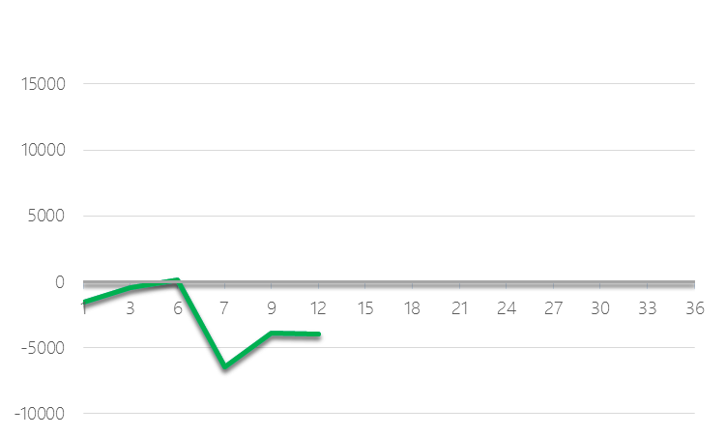
50.000
+6
1
Net income
Cumulative FCF

Slide 13
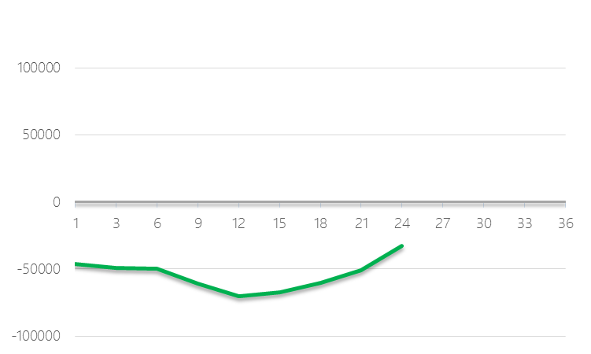
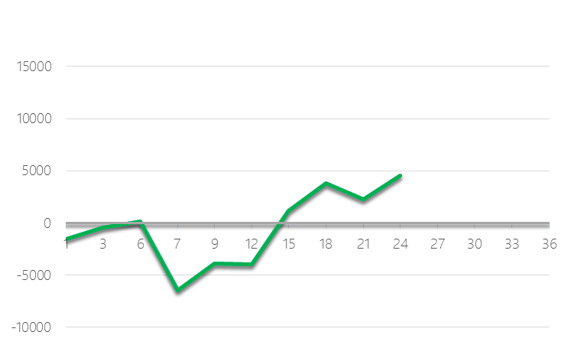
150.000
+10
2
Net income
Cumulative FCF

Slide 14
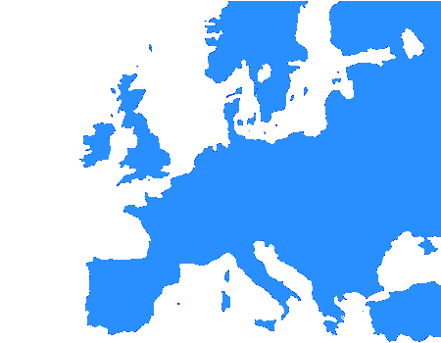
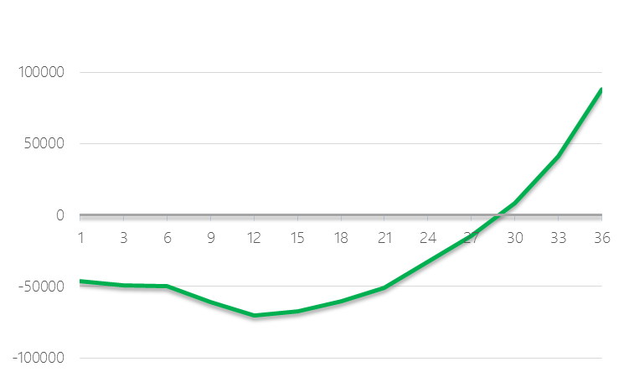
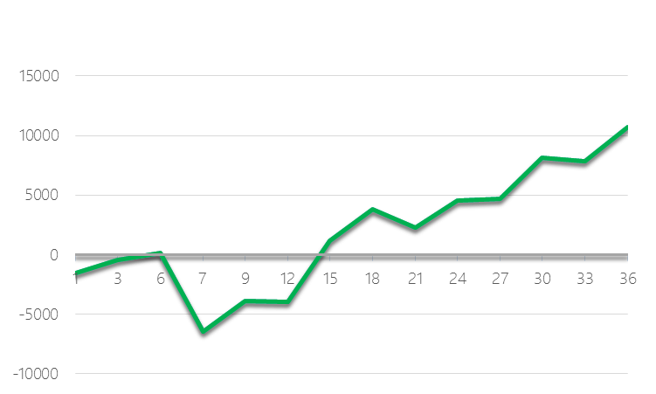
350.000
+16
3
Net income
Cumulative FCF

Slide 15
freemium
108,823€

Slide 16
fees
246,400 €
freemium
108,823€

Slide 17
ads
148,164 €
fees
246,400 €
freemium
108,823€

Slide 18
180M people
bootstrapping
ads
148,164 €
fees
246,400 €
freemium
108,823€

Slide 19
Investment Required: 45.000€
180M people
bootstrapping
ads
148,164 €
fees
246,400 €
freemium
108,823€

Slide 20
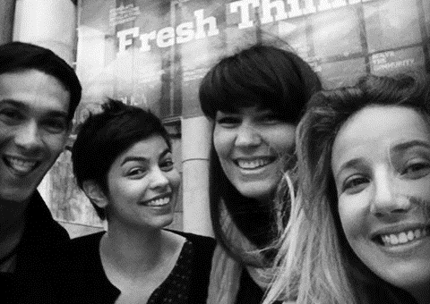
Thank you !

