Slide 1
Hi Joao!
What’s Up?
Log out
+ Add a teamwork
Semester Fall 2014
EBP LeadTeam
Business Ethics Team#4
Project Management Team#6
Brand Marketing Nike Project
10 news
Juan uploaded “empathy map.pdf“
Ana changed “persona profile”
Meeting on Thursday 21st at 3 pm, catolica cafeteria
Call from the chat on 1st of may, 3pm
Deadline on 5th of may
Teacher wrote a comment in “.docx”
…
5 news
Go !
Go !
No news, good news !
3 news
Go !
Go !

Slide 2
Week 4
Week 5
Book Meeting
Task Allocation
ANA
CLEMENCE
JUAN
M | T | W | T | F | S | S
 |  |  | 1 | 2 | 3 | 4
5 | 6 | 7 | 8 | 9 | 10 | 11
12 | 13 | 14 | 15 | 16 | 17 | 18
19 | 20 | 21 | 22 | 23 | 24 | 25
26 | 27 | 28 | 29 | 30 | 31
M | T | W | T | F | S | S
 |  |  | 1 | 2 | 3 | 4
5 | 6 | 7 | 8 | 9 | 10 | 11
12 | 13 | 14 | 15 | 16 | 17 | 18
19 | 20 | 21 | 22 | 23 | 24 | 25
26 | 27 | 28 | 29 | 30 | 31
M | T | W | T | F | S | S
 |  |  | 1 | 2 | 3 | 4
5 | 6 | 7 | 8 | 9 | 10 | 11
12 | 13 | 14 | 15 | 16 | 17 | 18
19 | 20 | 21 | 22 | 23 | 24 | 25
26 | 27 | 28 | 29 | 30 | 31
Chat
X
X
X
X
X
X
X
X
X
Manual
Upload my Calendar
Ana:
M | T | W | T | F | S | S
 |  |  | 1 | 2 | 3 | 4
5 | 6 | 7 | 8 | 9 | 10 | 11
12 | 13 | 14 | 15 | 16 | 17 | 18
19 | 20 | 21 | 22 | 23 | 24 | 25
26 | 27 | 28 | 29 | 30 | 31
Guys ! We should meet next week to discuss the case. What do you think ?
Seen at 10:00pm
Clémence:
Definitely ! I will upload my schedule
Send an invitation to the team for this date:
Monday 12th May
Thursday 15th May
GO !
Chat
Calendar
Files
Tasks

Slide 3
Week 4
Week 5
Book Meeting
Task Allocation
Docs
Edit
Sketch
Chat
Blog
Ana:
SWOT Analysis
Hey, I just finnished the Lessons Learned for this week, can you give feedback before posting on the blog? Thanks a lot ☺
Seen at 1:00pm
Lessons Learned
Clémence:
Sure! Going to check now, give me a min.
Chat
Calendar
Files
Tasks

Slide 4
Week 4
Week 5
Book Meeting
Task Allocation
Docs
Edit
Sketch
Chat
Blog
Ana:
SWOT Analysis
Hey, I just finnished the Lessons Learned for this week, can you give feedback before posting on the blog? Thanks a lot ☺
Seen at 1:00pm
Lessons Learned
Lessons Learned – week 4.docs
Clémence:
Sure! Going to check now, give me a min.
Seen at 1:01pm
Chat
Calendar
Files
Tasks

Slide 5
Week 4
Week 5
Book Meeting
Task Allocation
Docs
Edit
Sketch
Chat
Blog
Ana:
SWOT Analysis
Hey, I just finnished the Lessons Learned for this week, can you give feedback before posting on the blog? Thanks a lot ☺
Seen at 1:00pm
Lessons Learned
Lessons Learned – week 4.docs
Clémence:
Sure! Going to check now, give me a min.
Seen at 1:01pm
Chat
Calendar
Files
Tasks

Slide 6
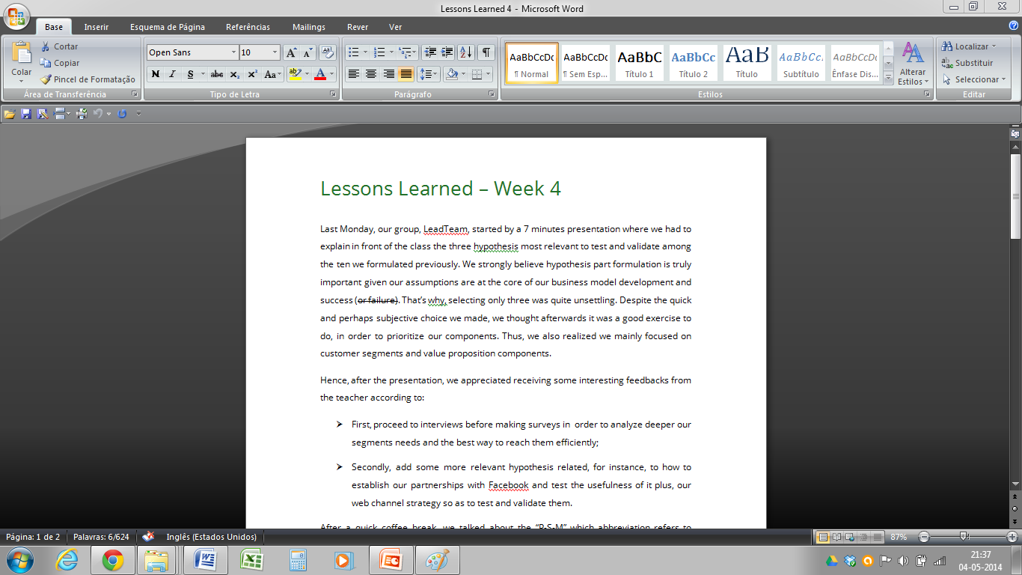
Week 4
Week 5
Book Meeting
Task Allocation
Docs
Edit
Sketch
Chat
Ana:
Lessons Learned – Week 4
Last Monday, our group, LeadTeam, started by a 7 minutes presentation where we had to explain in front of the class the three hypothesis most relevant to test and validate among the ten we formulated previously. We strongly believe hypothesis part formulation is truly important given our assumptions are at the core of our business model development and success (or failure). That’s why, selecting only three was quite unsettling. Despite the quick and perhaps subjective choice we made, we thought afterwards it was a good exercise to do, in order to prioritize our components. Thus, we also realized we mainly focused on customer segments and value proposition components.
Hence, after the presentation, we appreciated receiving some interesting feedbacks from the teacher according to:
First, proceed to interviews before making surveys in order to analyze deeper our segments needs and the best way to reach them efficiently;
Secondly, add some more relevant hypothesis related, for instance, to how to establish our partnerships with Facebook and test the usefulness of it plus, our web channel strategy so as to test and validate them.
After a quick coffee break, we talked about the “P-S-M” which abbreviation refers to “Problem-Solution-Market” concept. This useful three elements concept is helpful to design a profitable Business Model and is based on the following logical ideas:
P. Entrepreneurs should first identify the current problems or strong needs faced by the customers and test it by a scale ranking process (ex: problems needs severity, pain caused intensity);
S. Build an innovative solution by delivering customers a
What do you think about the first sentence?
Seen at 1:10pm
Clémence:
Ye… probably like this?
Seen at 1:11pm
Chat
Calendar
Files
Tasks

Slide 7
Week 4
Week 5
Book Meeting
Task Allocation
Docs
Edit
Sketch
Chat
Ana:
Lessons Learned – Week 4
Last Monday, our group, LeadTeam, started by a 7 minutes presentation where we had to explain in front of the class the three hypothesis most relevant to test and validate among the ten we formulated previously. We strongly believe hypothesis part formulation is truly important given our assumptions are at the core of our business model development and success (or failure). That’s why, selecting only three was quite unsettling. Despite the quick and perhaps subjective choice we made, we thought afterwards it was a good exercise to do, in order to prioritize our components. Thus, we also realized we mainly focused on customer segments and value proposition components.
Hence, after the presentation, we appreciated receiving some interesting feedbacks from the teacher according to:
First, proceed to interviews before making surveys in order to analyze deeper our segments needs and the best way to reach them efficiently;
Secondly, add some more relevant hypothesis related, for instance, to how to establish our partnerships with Facebook and test the usefulness of it plus, our web channel strategy so as to test and validate them.
After a quick coffee break, we talked about the “P-S-M” which abbreviation refers to “Problem-Solution-Market” concept. This useful three elements concept is helpful to design a profitable Business Model and is based on the following logical ideas:
P. Entrepreneurs should first identify the current problems or strong needs faced by the customers and test it by a scale ranking process (ex: problems needs severity, pain caused intensity);
S. Build an innovative solution by delivering customers a
I actually prefer like that!
Seen at 1:20pm
Clémence:
Cool
Seen at 1:21pm
Chat
Calendar
Files
Tasks

Slide 8
Week 4
Week 5
Book Meeting
Task Allocation
Docs
Edit
Sketch
Chat
Blog
Ana:
Empathy Map
Hey, let’s do the Empathy Map together?
Seen at 10:00am
Lessons Learned
Clémence:
Sure!
Seen at 10:00am
Chat
Calendar
Files
Tasks

Slide 9
Week 4
Week 5
Book Meeting
Task Allocation
Docs
Edit
Sketch
Chat
Blog
Ana:
Empathy Map
Hey, let’s do the Empathy Map together?
Seen at 10:00am
Empathy Map.png
Clémence:
Lessons Learned
Sure!
Seen at 10:00am
Chat
Calendar
Files
Tasks

Slide 10
Week 4
Week 5
Book Meeting
Task Allocation
Docs
Edit
Sketch
Chat
Blog
Ana:
Empathy Map
Hey, let’s do the Empathy Map together?
Seen at 10:00am
Empathy Map.png
Clémence:
Lessons Learned
Sure!
Seen at 10:00am
Chat
Calendar
Files
Tasks

Slide 11
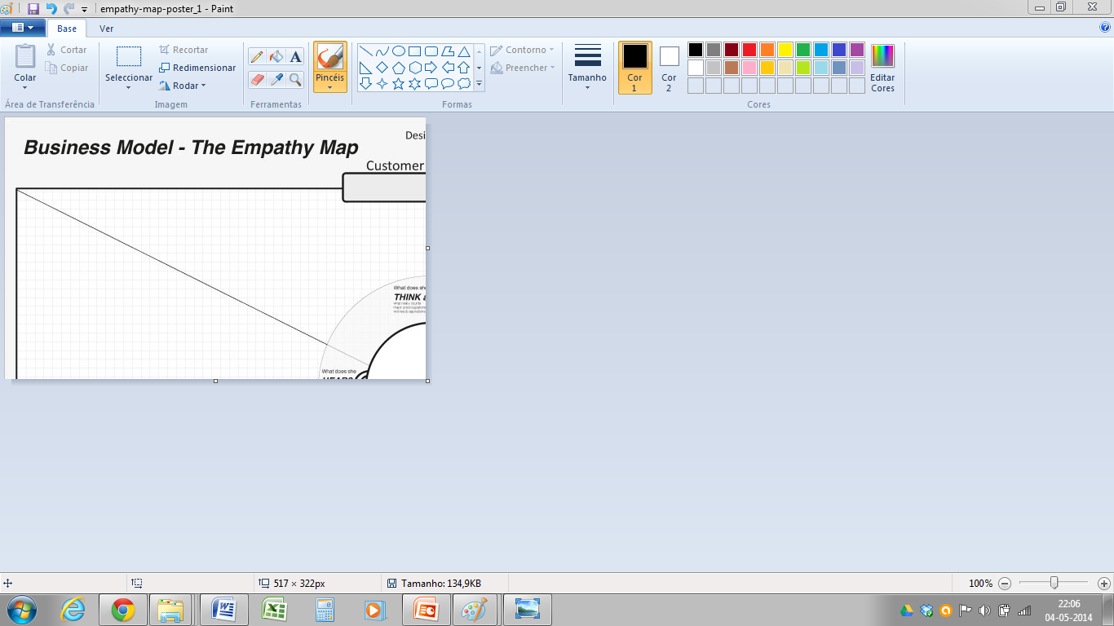
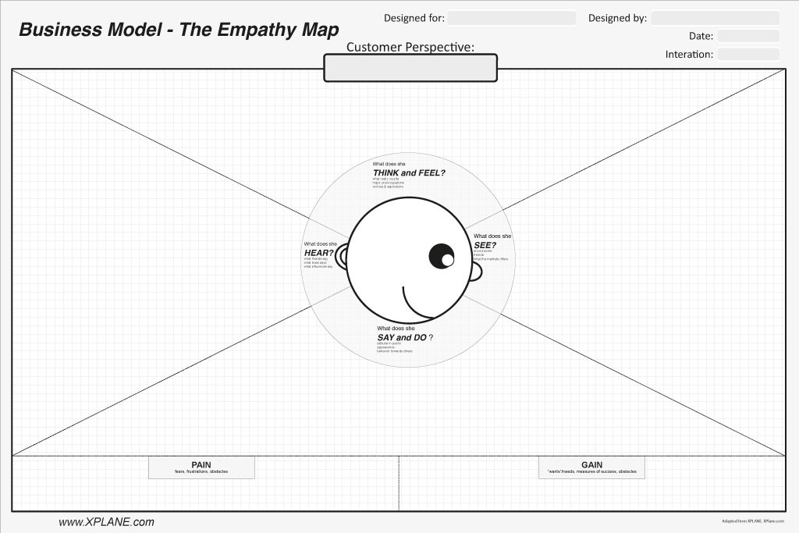
Week 4
Week 5
Book Meeting
Task Allocation
Docs
Edit
Sketch
Chat
Ana:
Hey, let’s do the Empathy Map together?
Seen at 10:00am
Clémence:
Sure!
Seen at 10:00am
Chat
Calendar
Files
Tasks

Slide 12
Week 4
Week 5
Book Meeting
Task Allocation
Docs
Edit
Sketch
Chat
Ana:
What do you think about « You won’t find a job »?
Seen at 10:04pm
Clémence:
What about « You need to work hard »?
Seen at 10:04pm
Chat
Calendar
Files
Tasks

Slide 13
Week 4
Week 5
Book Meeting
Task Allocation
Docs
Edit
Sketch
Chat
Ana:
Blog
Empathy Map
Hey, let’s do the Empathy Map together?
Seen at 10:00am
Lessons Learned
What do you think about « You won’t find a job »?
Seen at 10:04pm
Chat
Calendar
Files
Tasks

Slide 14
 | T1 | T2 | T3
 | Deadline: 02/05 Days to go: 5 | Deadline: 03/05 Days to go: 6
 |  |  | Deadline: 30/04 1 file linked Days to go: 2
 | Deadline: 02/05 Days to go: 5
Create landing page
Modify
Do PPT Presentation
Modify
Design survey
+
Modify
Team’s
Yours
 | 28 04 | 29 04 | 30 04 | 01 05 | 02 05 | 03 05 | 04 05 | 05 05 | 06 05 | 07 05 | 08 05 | 09 05 | 10 05 | 11 05 | 12 05
T1
T2
Chat
Calendar
Files
Tasks

Slide 15
Week 4
Week 5
Book Meeting
Task Allocation
Chat
 | T1
 | Deadline: 02/05 Days to go: 5
 | Deadline: 02/05 Days to go: 5
+
Create landing page
Modify
Ana:
Who is creating the landing page?
Seen at 1:00am
Clémence:
Juan is doing the layout and you are implementing it on unbounce
Seen at 1:01am
Team’s
Yours
 | 28 04 | 29 04 | 30 04 | 01 05 | 02 05 | 03 05 | 04 05
T1
T2
Chat
Calendar
Files
Tasks

